Slide 1

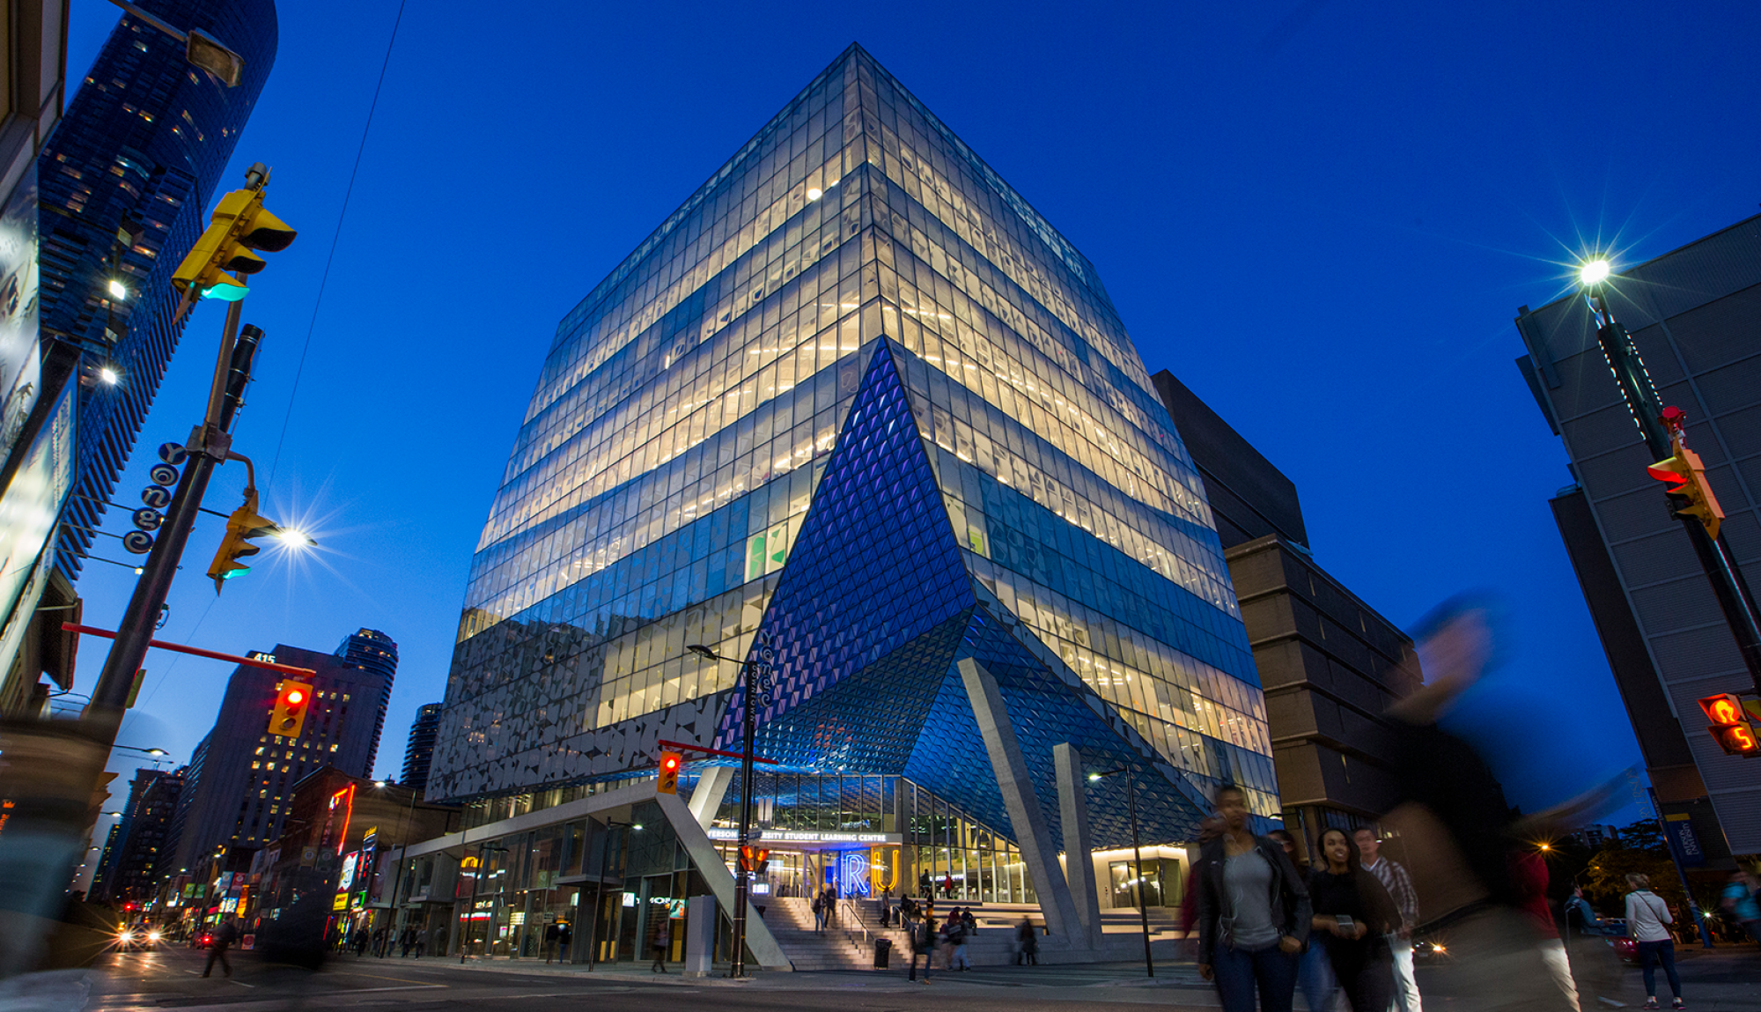
On-Demand Transit and the Next Gen of Public Mobility
Bilal Farooq, Ryerson University
Web: https://bilalfarooq.com/
Twitter: @billjee

Slide 2

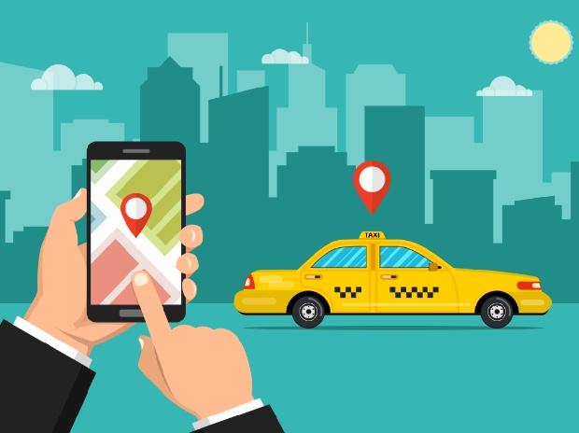
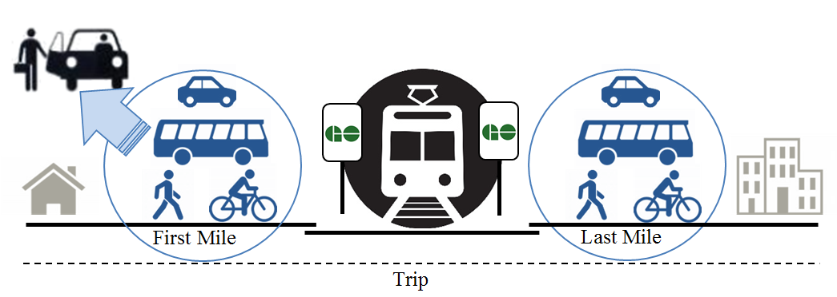
On-Demand Transit (ODT)
Advancements in Information and Communication Technology (ICT)
Flipping the conventional model of mobility supply and service
Mobility as a (highly demand responsive) Service (MaaS)
On-Demand Transit
ODT solutions
Low demand/sparsely populated areas
First-mile/Last-mile demand

Slide 3
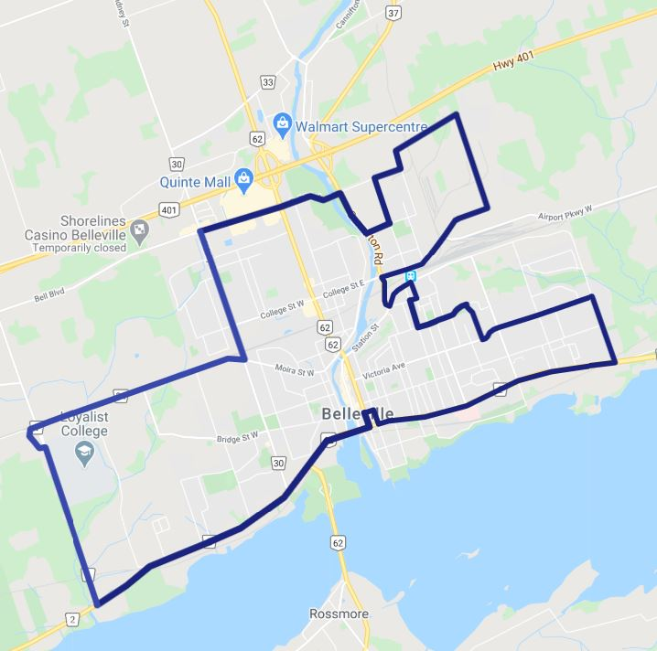
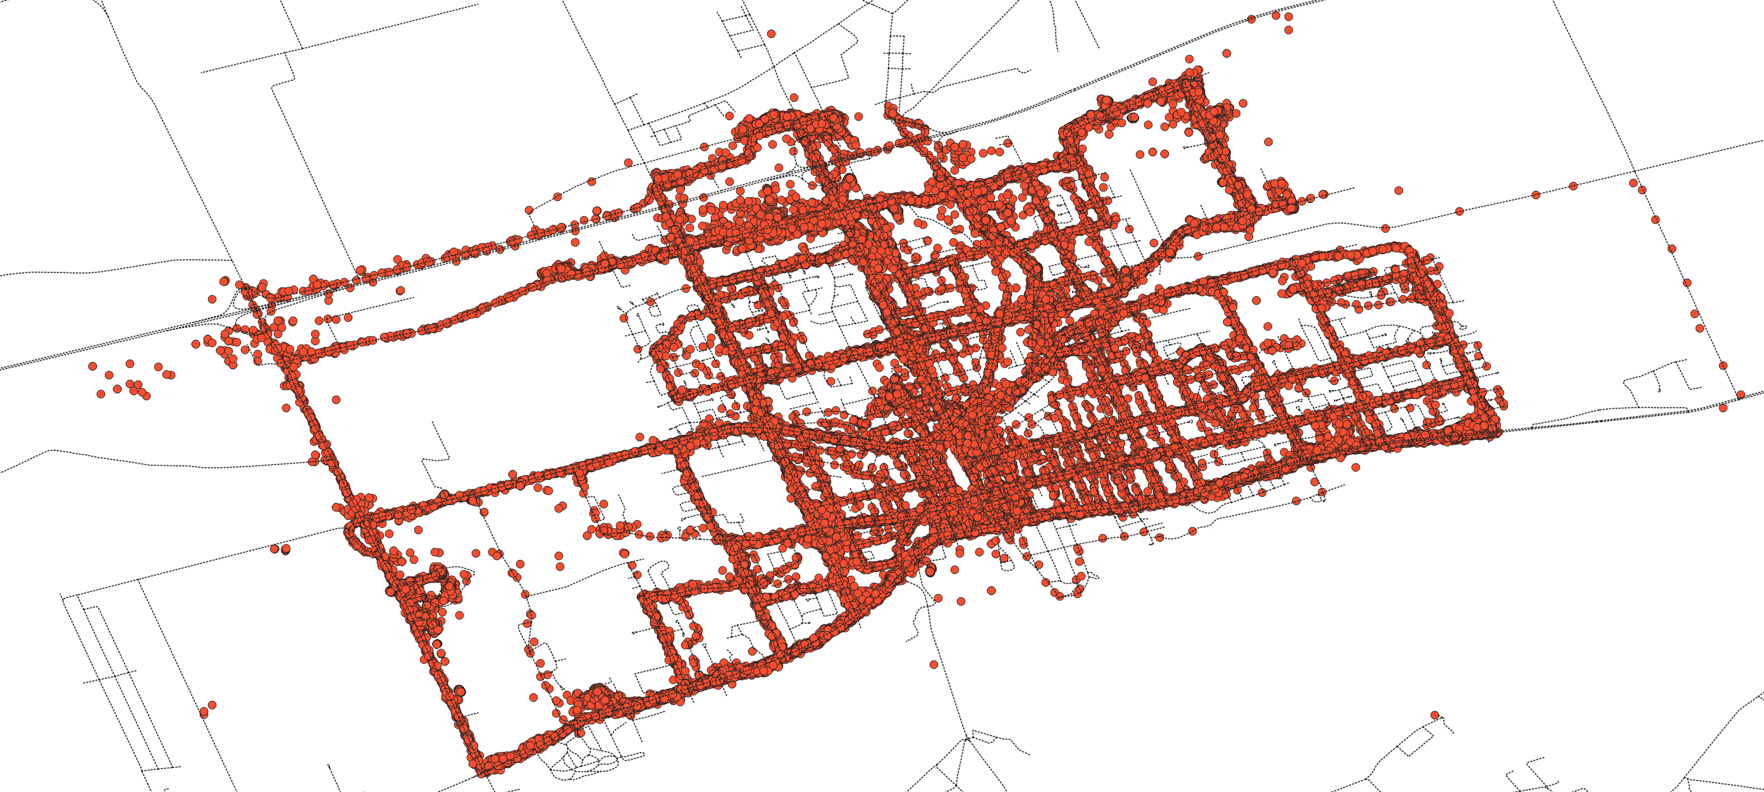
On-Demand Transit: Belleville Example
ODT Service
Fixed Service

Slide 4
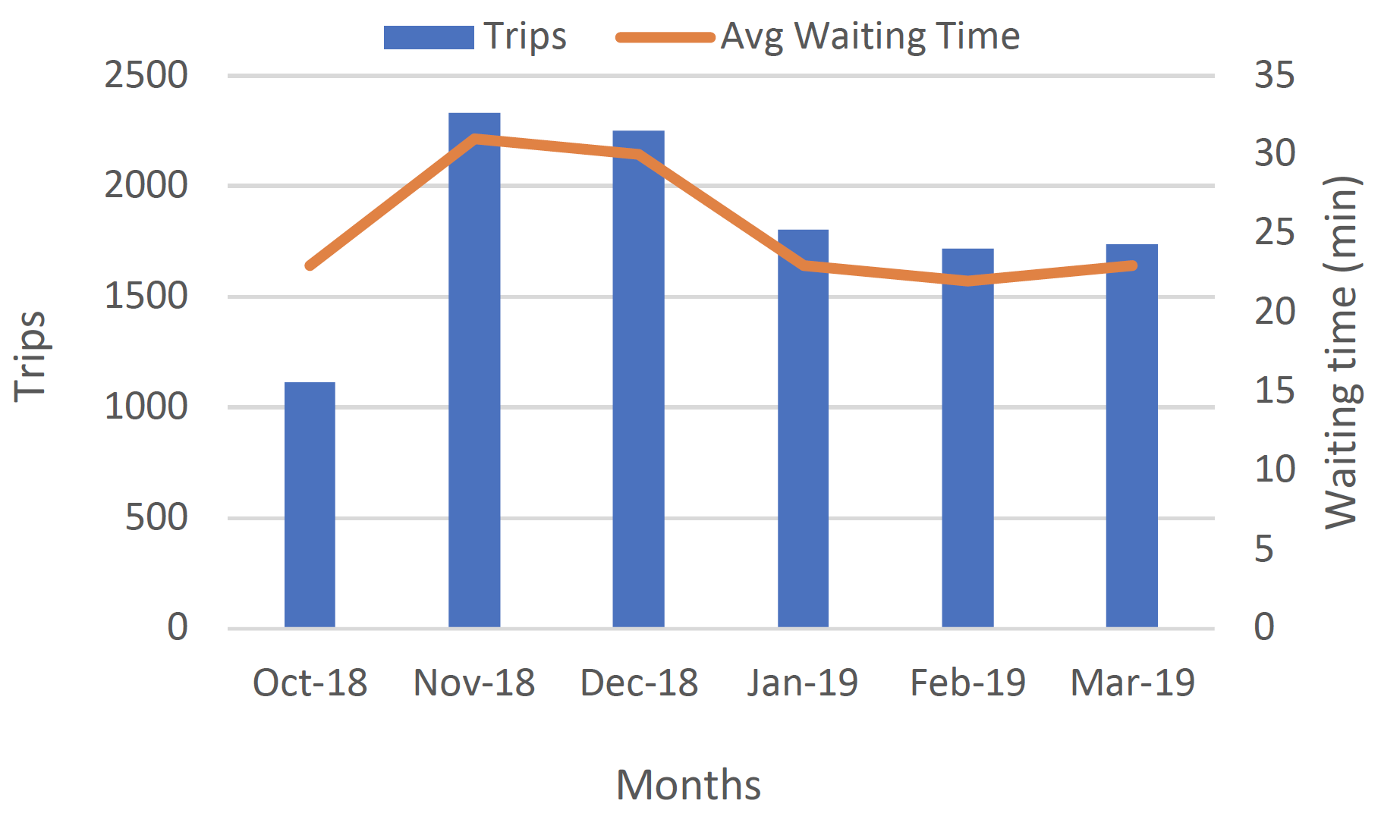
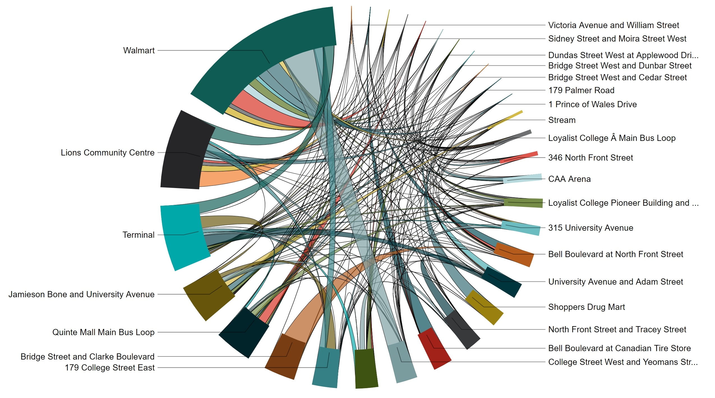
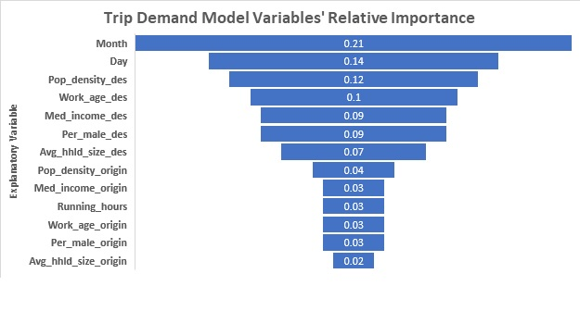
Origin-Destination Flow

Slide 5
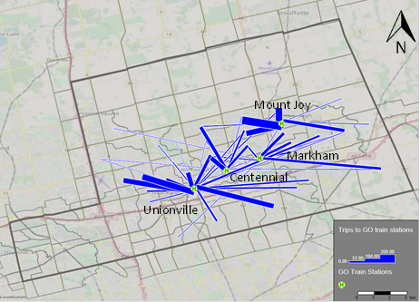
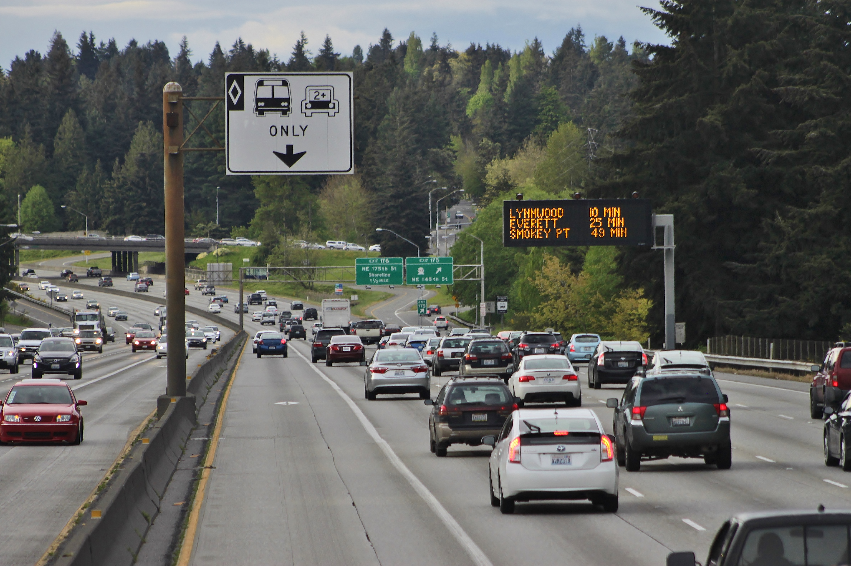
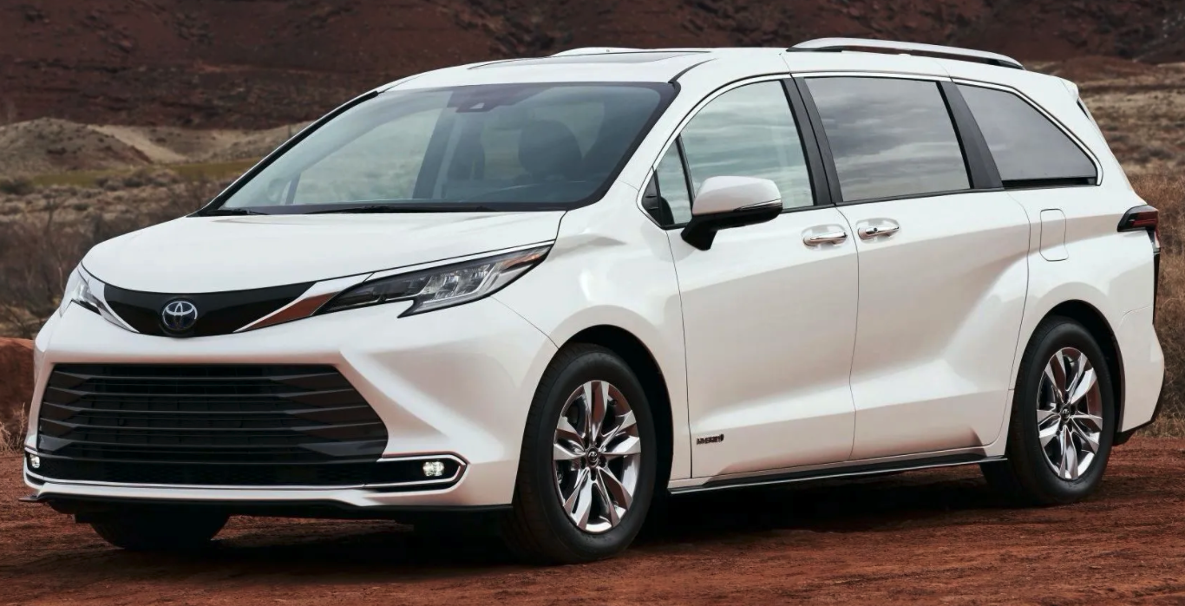
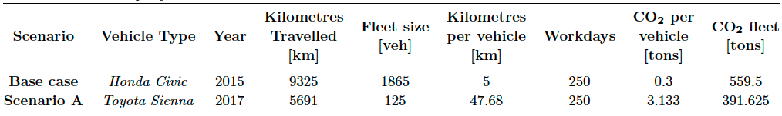
Markham First-Mile On-Demand Transit

Slide 6
Key Takeaways
Strong role for ODT services
Low density areas and first/last mile
Potential to contribute to sustained increase in ridership
Level of service improvements possible by
Spatio-temporal demand prediction
Real-time supply optimization
Has the potential to be operationally more cost effective
Coordination with high-frequency fixed route public transit

